Slide 1
A Presentation
Presenter

Slide 2
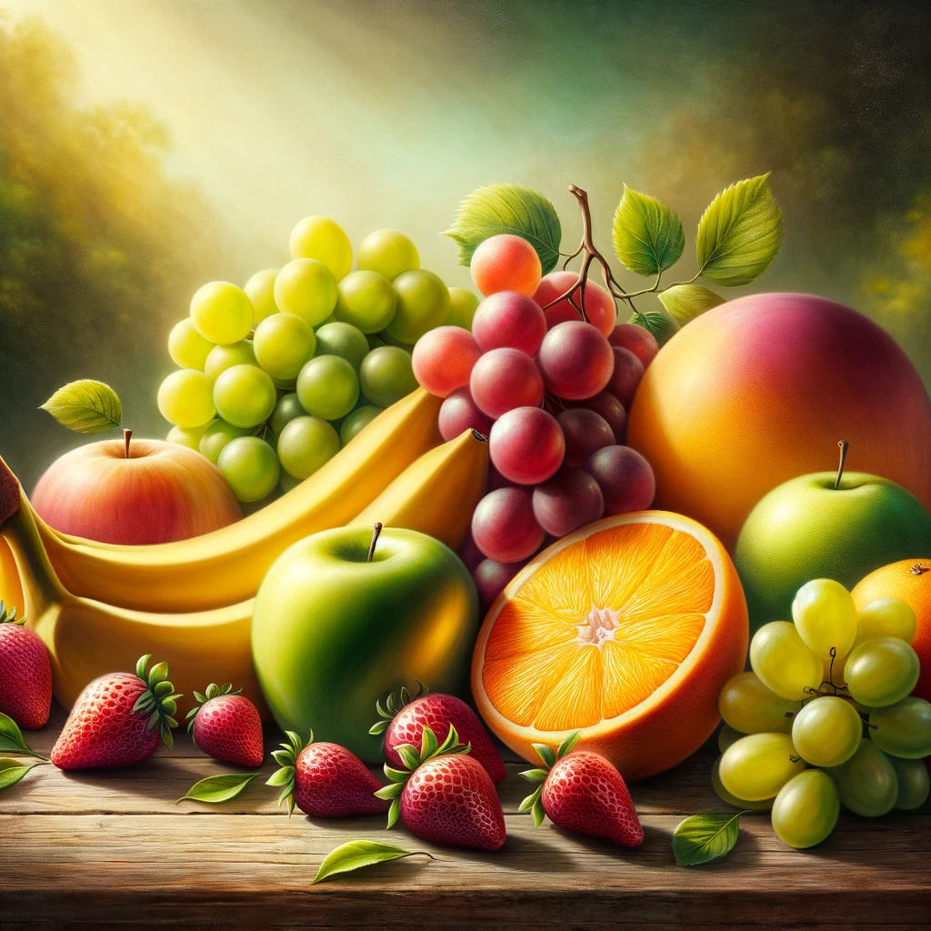
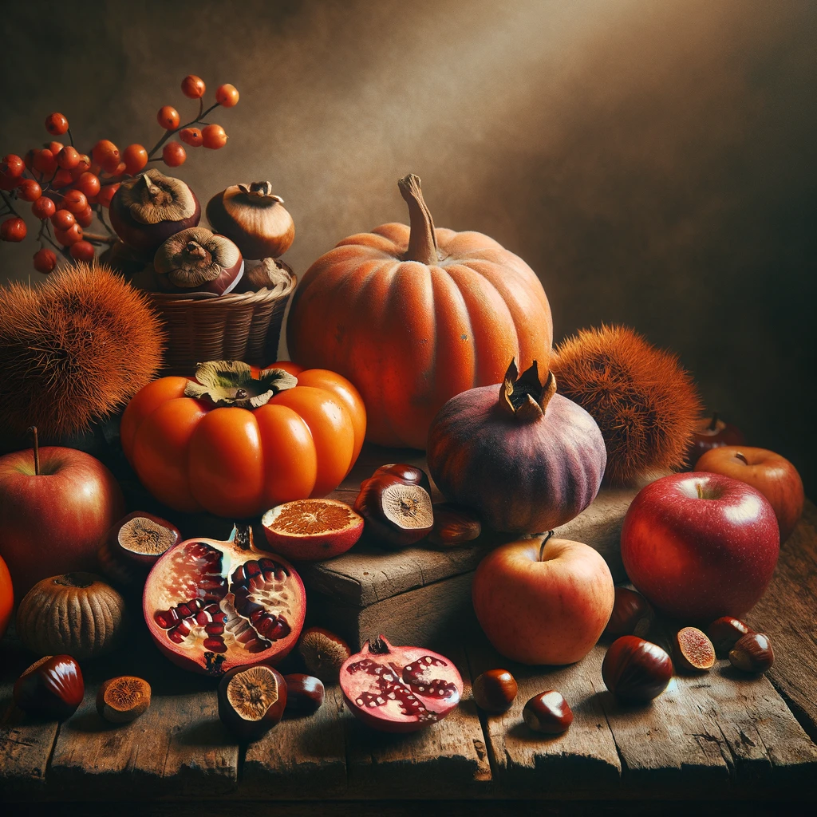
Fruits
DALL-E 3

Slide 3
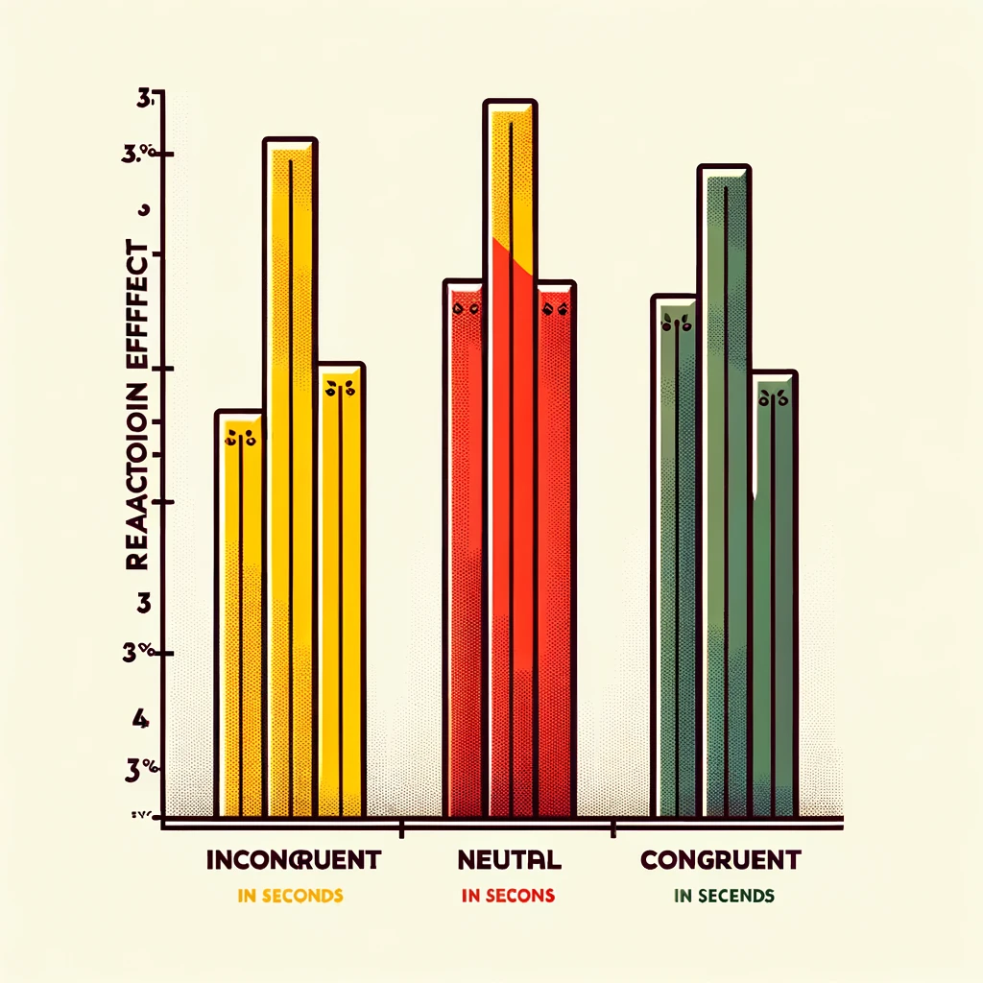
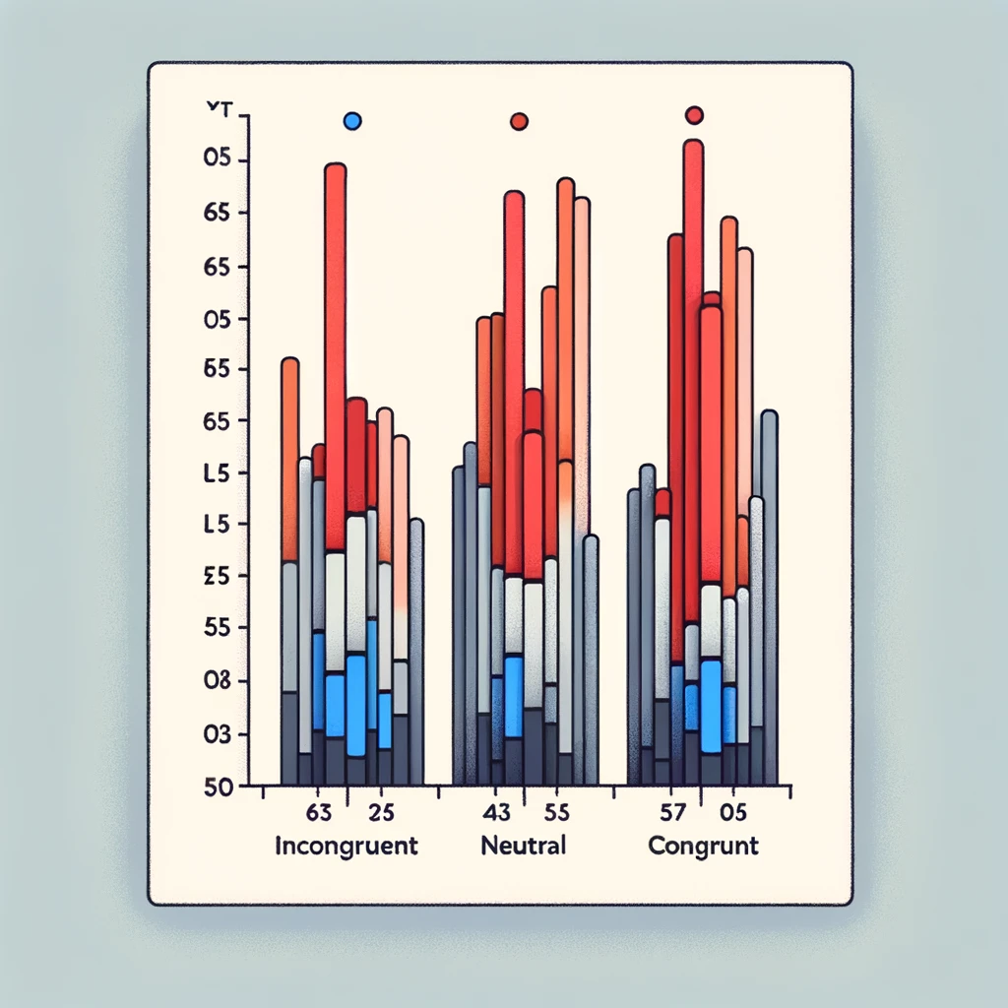
Graphs (grouped)
DALL-E 3
Notes:
Grouped images

Slide 4



Shaped grouped
Notes:
Shapes copied from Keynote, combined in group

Slide 5
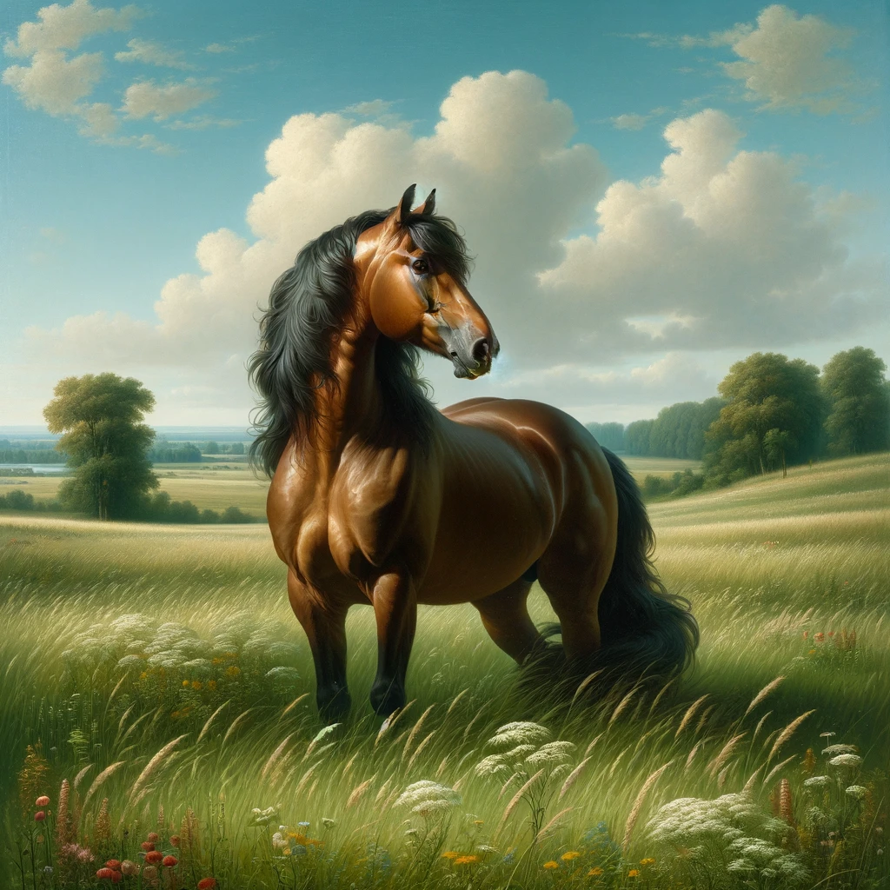
Image and text grouped
DALL-E 3
Notes:
Image and text grouped

Slide 6
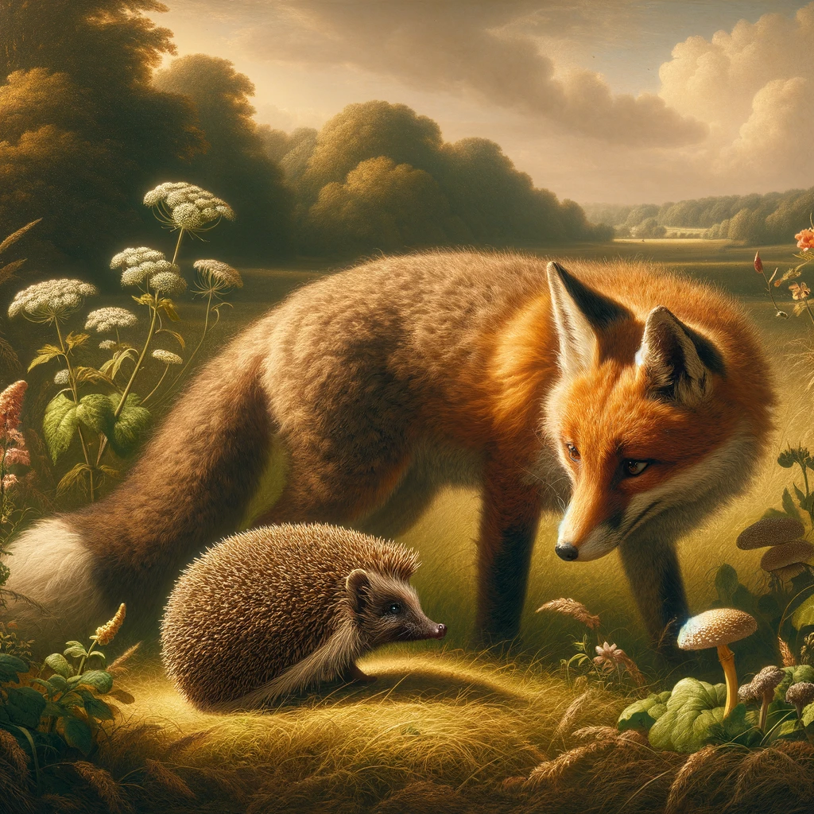
Slide
DALL-E 3
Notes:
Image and text grouped

